Slide 1
Developed by You

Slide 2
Hypervisor Extensions for Virtual Machine Memory Introspection
Ravi Sahita– Principal Engineer, Intel Corporation
Andrei Luțaș – Senior Introspection Research Lead, Bitdefender
ISGS002

Slide 3
Agenda
Security Trends
Memory introspection
Promises, Capabilities & Challenges
Hardware Memory Introspection Extensions and Opportunities
Hypervisor Memory Introspection Extensions
Memory Introspection Scenarios
Conclusions

Slide 4


About the Speakers
Ravi Sahita
Security Architect and Principal Engineer at Intel Labs, directing research on software security, malware analysis and prevention. He defined innovative CPU and software capabilities for platform security, including VM introspection technologies and new CPU features supporting introspection shipping in Intel® Core™ and Intel® Atom™ Processors.
Andrei Luțaș
Senior Introspection Research Lead at Bitdefender, directing research on memory introspection based security solutions. He created innovative technologies capable of protecting live VMs, both at kernel-mode and user-mode application levels. He carries out intensive research to enhance memory introspection security technologies.

Slide 5
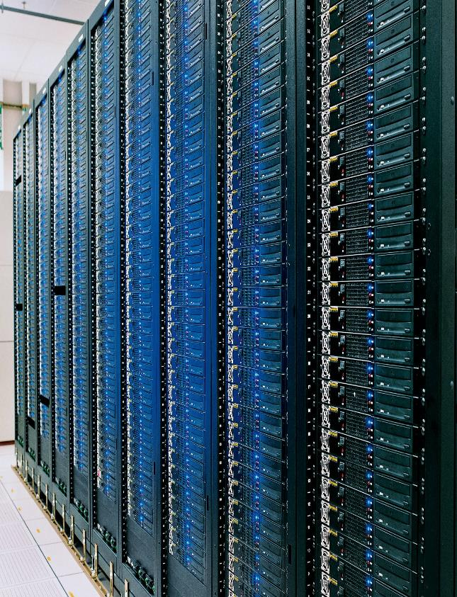
Security Trends
Memory introspection Promises, Capabilities, and Challenges
Hardware Extensions
Hypervisor Extensions
Memory Introspection Scenarios
Conclusions

Slide 6
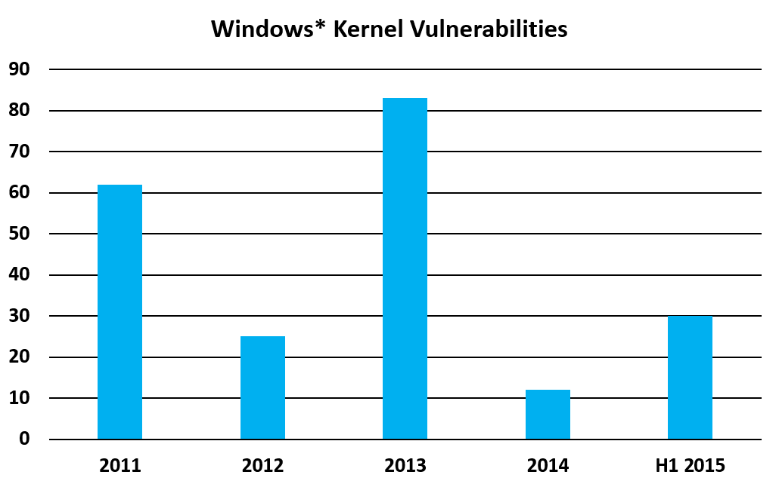
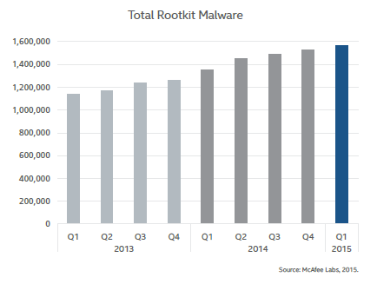
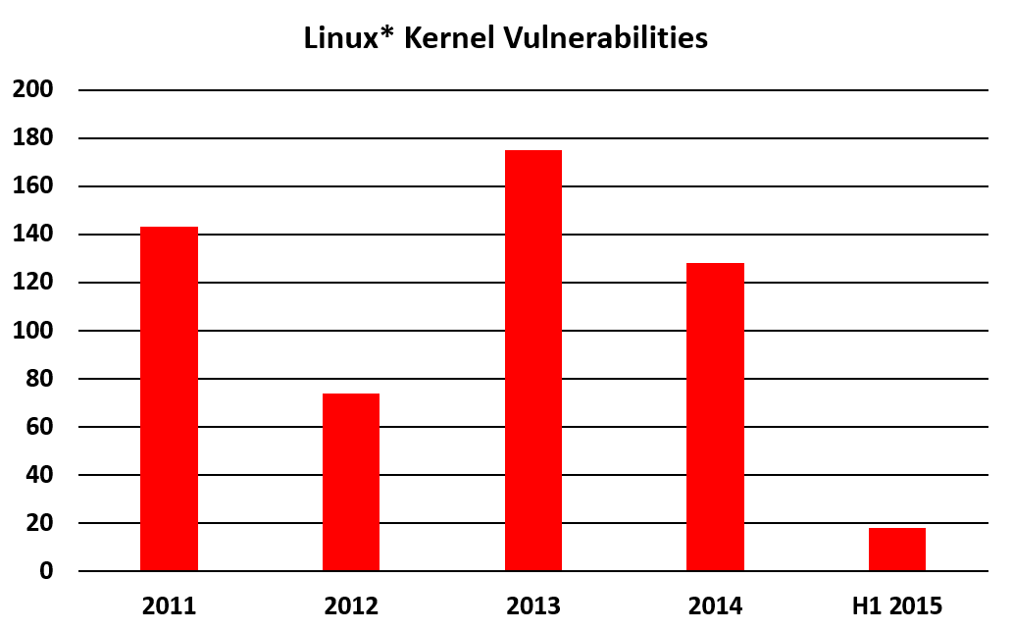
Security Trends
®
Advanced Persistent Threats (APTs), botnets, cyber-espionage heavily rely on:
Rootkits
Kernel exploits
0-days
Total Rootkit Malware
Source: based on nvd.nist.gov
Source: Intel® Security – McAfee* Labs Threats Report, May 2015
Source: based on nvd.nist.gov

Slide 7
Advanced Persistent Threats (APTs) Action-flow
Spear phishing
Drive-by downloads
Trojans
Code injection → Energetic Bear APT, Epic Turla, Zeus, …
API hooking → Dyreza, GameOver…
Espionage & data exfiltration
Identity theft
Sabotage
1. infection vector
2. exploit
3. user-app payload
4. kernel payload
5. remote control of victim
CVE-2012-0158 → APT28
CVE-2013-1347 → Energetic Bear APT
CVE-2014-0497 → DarkHotel APT
…
Stealthiness & persistence → kernel rootkits (Necurs, TDL), bootkits, …
Notes:
CVE-2012-0158 – malicious RTF, MS12-027 MSCOMCTL ActiveX Buffer Overflow
CVE-2013-1347 – MS13-038 Microsoft Internet Explorer 8 CGenericElement Object Use-After-Free Vulnerability, remote code execution
CVE-2014-0497 – Adobe Flash Player Integer Underflow Remote Code Execution, remote code execution
…

Slide 8


Why Does Advanced Malware Succeed?
Common Malware
Advanced Malware
App1 (Office)
App2 (Browser)
Security Solution
App1 (Office)
App2 (Browser)
Security Solution
Drivers
OS Kernel
Security Filter
Drivers
OS Kernel
Security Filter
ISOLATION Kernel Controlled
ISOLATION Kernel Controlled
Isolation Bypassed, Malware has control
Advanced attacks evade traditional in-OS security approaches

Slide 9
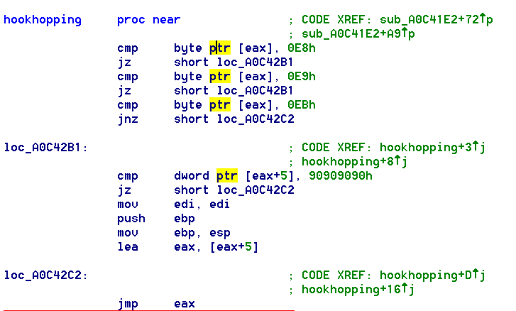
Evasive Malware Behavior
Hook-skipping ShellCode in CVE-2013-0634
Read memory for APIs
Does entry point have jmp to hook?
Yes
No
Skip hook bytes
Invoke API

Slide 10
Security Trends
Memory introspection Promises, Capabilities, and Challenges
Hardware Extensions
Hypervisor Extensions
Memory Introspection Scenarios
Conclusions

Slide 11
What is Virtual Machine (VM) Memory Introspection?
Provide security from outside the guest OS
Not relying on OS for isolation of security services
Not exposed to advanced threats
Direct access to analyze memory of guest OS and applications
Hook memory as non-execute or non-writable using hardware extensions
Hooking & notification must be supported efficiently by CPU
Audit accesses by code running in guest VM / OS
Write attempts, Execution attempts
Allow or deny attempts – decision provided by security logic

Slide 12
Intel® Virtualization Technology for IA-32, Intel® 64 and Intel® Architecture (Intel® VT-x) Extended Page Tables Short Introduction
VM₀
OS kernel
code/data
(RX/RW)
Driver
code (RO)
Data
(NP)
OS kernel
code/data
(RO/NP)
Driver code (RX)
Data
(RW)
Extended Page Table (EPT) domains
Hypervisor
Intel® VT-x with EPT
Execution crossing EPT domains or data accesses causing EPT events
CPU₀
EPT Walker
Host Physical Address
Intel® Virtualization Technology for IA-32, Intel® 64 and Intel® Architecture (Intel® VT-x) with Extended Page Tables (Intel® VT-x with EPT)

Slide 13
Memory Introspection How does it work?
EPT protected areas
provide detection of alteration attempts, ensuring protection of critical code & data
OS kernel code
user mode stacks & heaps
kernel driver code and data
user mode code
critical kernel data System Service Dispatch Table (SSDT), Interrupt Descriptor Table (IDT), …
Guest VM
Physical Memory Space
EPT protected areas
detection of operations & events (ex. module load, process start, paging structures change, …)

Slide 14
Memory Introspection Challenges
Bridging the Semantic Gap – Correlate memory page accesses with meaningful OS data structures and operations
What objects are inside a guest VM?
What operations are being performed inside a guest VM?
Solved by security solution vendors
Performance – Forward interesting memory-events with low overhead to Memory-Introspection engine
Solved by Hypervisor and CPU
Evasive Malware – Minimizing evidence of instrumentation
Ongoing research

Slide 15
Memory Introspection via Hypervisors Big picture overview
Hypervisor Controlled, Hardware Enforced STRONG ISOLATION
Management
domain
Security
domain
User Domain 1
User
Domain 2
User Domain N
Introspection Engine
Introspection Engine
Introspection Engine
Introspection Engine
policy
events
policy
events
Hypervisor
EPT Domains
EPT Domains

Slide 16
Security Trends
Memory introspection Promises, Capabilities, and Challenges
Hardware Extensions
Hypervisor Extensions
Memory Introspection Scenarios
Conclusions

Slide 17
VM Introspection Performance Challenges
Round-trip time
EPT based monitoring causes VMexits in legacy CPUs
High frequency of such “induced” events is overhead
Event filtering
Many events are “un-interesting”
Round-trip time amplification due to hypervisor nesting
Any EPT violation VMexits caused due to VM introspection are reported to “root” hypervisor and must be emulated to “guest” hypervisor

Slide 18
Asynchronous Induced VMexits
Guest Kernel
In VM-introspection scenarios critical data is monitored in place
Legacy approaches are to VMexit and emulate access
High write-frequency of monitored data cause high overhead
Needs custom logic in hypervisor, increasing complexity/state
Monitored
Memory
In/Out Guest
Introspection
Engine
Memory
View
WRITE
Access Check
2
7
1
3
4
5
6
Hypervisor
EPT
Emulation

Slide 19
Accelerating Induced Events
Guest Kernel
Virtualization Exception (#VE) mutates EPT violations into a new Intel® Architecture exception – delivered through guest IDT
Hypervisor explicit opt-in to #VE
Data access introspection causes #VE instead of VMexit
Guest monitoring agent can emulate in guest OR use VMFUNC to single step access
3
#VE
VMFUNC
Monitored
Memory
Introspection
Engine
Memory
View
WRITE
Access Policy
2
4
VMFUNC
Hypervisor
1
EPT Domains
EPT Domains

Slide 20
Memory Introspection via a Nested Hypervisor Acceleration Extensions
General Intel VT-x nesting acceleration
Enables root hypervisor to manage “shadow” VMCS for guest hypervisors
Avoids VMexits for VMREAD, VMWRITEs
Other virtualization specific instructions still cause VMexits
Intel VT-x nested memory introspection acceleration
0 VMexits when using VMFUNC to switch EPTs
0 VMexits for converting EPT violations to #VE
No VMexits ➔ No Nested VMexits
Other monitored events still cause VMexits but are infrequent
Intel® Virtualization Technology for IA-32, Intel® 64 and Intel® Architecture (Intel® VT-x) VMCS – Virtual Machine Control Structure

Slide 21
Nested Memory Introspection Operation Reducing Performance Overheads by eliminating nested VM exits
STRONG ISOLATION
Guest VM 1
Guest VM 2
Guest VM N
#VE based Introspection Engine
#VE based Introspection Engine
#VE based Introspection Engine
lightweight security (guest) hypervisor 1
lightweight security (guest) hypervisor 2
lightweight security (guest) hypervisor N
LEVEL 2
3rd party ROOT Hypervisor
needs to expose CPU VM-introspection features (VMFUNC, #VE) for guest hypervisors
LEVEL 1

Slide 22
VM Introspection Performance Improvements
Round-trip time eliminated (0 VMexits)
VMFUNC to allow safe and low-latency EPT switching
VMexits mutated to #VE for memory introspection policy handling
Low-latency event filtering
Reduced latency of #VE event handling reduces overhead of events
No round-trip time amplification due to hypervisor nesting
No VMexits to root hypervisor implies no amplification of VMexits due to EPT violations

Slide 23
Security Trends
Memory introspection Promises, Capabilities, and Challenges
Hardware Extensions
Hypervisor Extensions
Memory Introspection Scenarios
Conclusions

Slide 24
Memory Introspection via Xen*
Hypervisor Controlled, Hardware Enforced STRONG ISOLATION
dom0
Security
domU
domU 1
domU 2
domU N
Introspection Engine
Introspection Engine
policy
events
policy
events
Xen*
Altp2m + Vm_event Extensions part of Xen 4.6 (ongoing)

Slide 25
Hypervisor Memory Introspection Xen* Extensions Patches submitted by Intel
Maintaining alternate EPT domains (called p2m in Xen) via addition of an altp2m capability in Xen*
HVM Hypercalls to manage altp2m without conflicting with Xen memory management for other use cases
Both, in-guest and out-of guest agents can utilize altp2m capabilities
In-guest agents can use VMFUNC to switch p2m for various usages
Report guest-specific EPT memory access events via #VE
Enabling CPU acceleration automatically if VMFUNC and #VE CPU enumerated and opted-in

Slide 26
Hypervisor Memory Introspection Xen* Extensions Patches submitted by Bitdefender*
Emulate an instruction and discard the written data to prevent patching
Attach the guest state (vCPU registers) to the memory event
Generate VMexits for introspection-relevant Model Specific Register (MSR) accesses by the guest OS
Disable the REP prefix support in the emulator when introspecting
Deny Model Specific Register & Control Register writes by the guest
Introspection specific VMCALL support (hypercall), used when injecting an application into the guest
Support for memory content hiding (compatible with PatchGuard*)
Various other cleanups in the VM event subsystem

Slide 27
Security Trends
Memory introspection Promises, Capabilities, and Challenges
Hardware Extensions
Hypervisor Extensions
Memory Introspection Scenarios
Conclusions

Slide 28
Memory Introspection Scenarios
Hypervisor-based Memory Introspection (HVMI) solution
Protected by USER MODE introspection
App1 (Office)
App2 (Browser)
Security Solution
Drivers
OS Kernel
Security Filter
Protected by KERNEL MODE introspection
Hypervisor
Memory Introspection Engine
ISOLATION -- HVMI controlled & ENFORCED by HARDWARE

Slide 29
User Mode Memory Introspection
Monitor user applications (such as web-browsers, Microsoft* Office, Adobe* Reader, …) for
detection of code injection
detection of function detouring
detection of code execution from stack / heap
detection of malicious code unpacking
enforcement of generic Write-XOR-eXecute (W⊕X) policy
specific events
Injection of remediation tools into the guest runtime on-the-fly (no help from ‘within’ guest needed)

Slide 30
Fighting APTs with HVMI
Espionage & data exfiltration
Identity theft
Sabotage
Spear phishing
Drive-by downloads
Trojans
Code injection → Energetic Bear APT, Epic Turla, Zeus, …
API hooking → Dyreza, GameOver…
KERNEL MODE HVMI
1. infection vector
2. exploit
3. user-app payload
4. kernel payload
5. remote control of victim
CVE-2012-0158 → APT28
CVE-2013-1347 → Energetic Bear APT
CVE-2014-0497 → DarkHotel APT, …
Stealthiness & persistence → kernel rootkits (Necurs, TDL), bootkits, …
Notes:
CVE-2012-0158 – malicious RTF, MS12-027 MSCOMCTL ActiveX Buffer Overflow
CVE-2013-1347 – MS13-038 Microsoft Internet Explorer 8 CGenericElement Object Use-After-Free Vulnerability, remote code execution
CVE-2014-0497 – Adobe Flash Player Integer Underflow Remote Code Execution, remote code execution
…

Slide 31
Fighting APTs with HVMI
USER MODE HVMI
Espionage & data exfiltration
Identity theft
Sabotage
Spear phishing
Drive-by downloads
Trojans
Code injection → Energetic Bear APT, Epic Turla, Zeus, …
API hooking → Dyreza, GameOver…
KERNEL MODE HVMI
1. infection vector
2. exploit
3. user-app payload
4. kernel payload
5. remote control of victim
CVE-2012-0158 → APT28
CVE-2013-1347 → Energetic Bear APT
CVE-2014-0497 → DarkHotel APT, …
Stealthiness & persistence → kernel rootkits (Necurs, TDL), bootkits, …
UM HVMI is STRONGLY ISOLATED (enforced by hardware) and provides GENERIC detection mechanisms
Notes:
CVE-2012-0158 – malicious RTF, MS12-027 MSCOMCTL ActiveX Buffer Overflow
CVE-2013-1347 – MS13-038 Microsoft Internet Explorer 8 CGenericElement Object Use-After-Free Vulnerability, remote code execution
CVE-2014-0497 – Adobe Flash Player Integer Underflow Remote Code Execution, remote code execution
…

Slide 32
DEMO
Xen* + hardware-accelerated VM introspection Addressing evasive malware
Xen + Bitdefender* HVMI User mode introspection & flexibility

Slide 33
Speedup Achieved via CPU acceleration #VE
Overall 15-20% faster process startup with #VE handler based HVMI
Overall 10% faster process execution with #VE handler based HVMI
Source: Bitdefender* analysis
TBD: disclaimer

Slide 34
Research Areas for Future HVMI Improvements
There are areas where introspection can be improved, like
A/D bit updates by CPU page-walker generates a lot of not-needed VMexits, especially when doing user-mode introspection
Memory monitoring is done on 4K page granularity – this generates a lot of not-needed VMexits
Better decode capabilities – a lot of VMexits on same instructions
Technical feedback on these and other areas are welcome

Slide 35
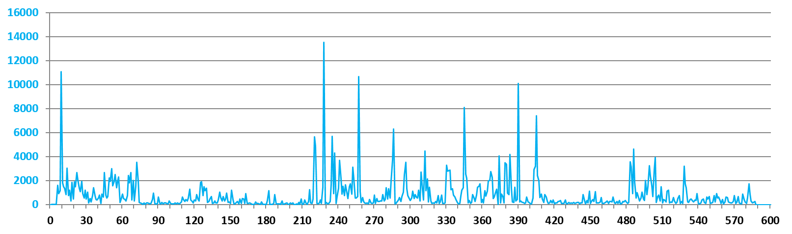
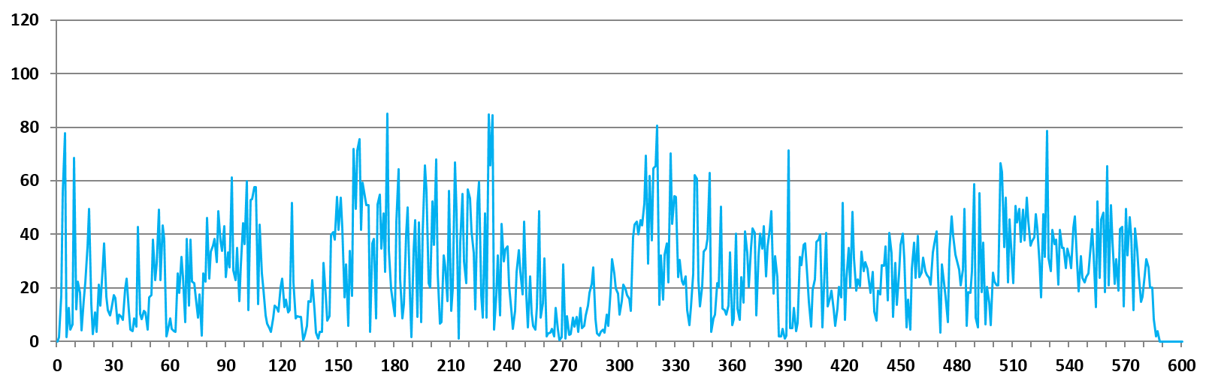
Frequency of A/D Write Events (by CPU Page-Walk)
VMexits due to EPT violation induced by CPU page-walker updates of guest A/D bits
Typical office applications workload
(e.g. web browsing, document editing, …)
Percentage of A/D bit update generated EPT violations out of all violations
Source: Bitdefender* analysis

Slide 36
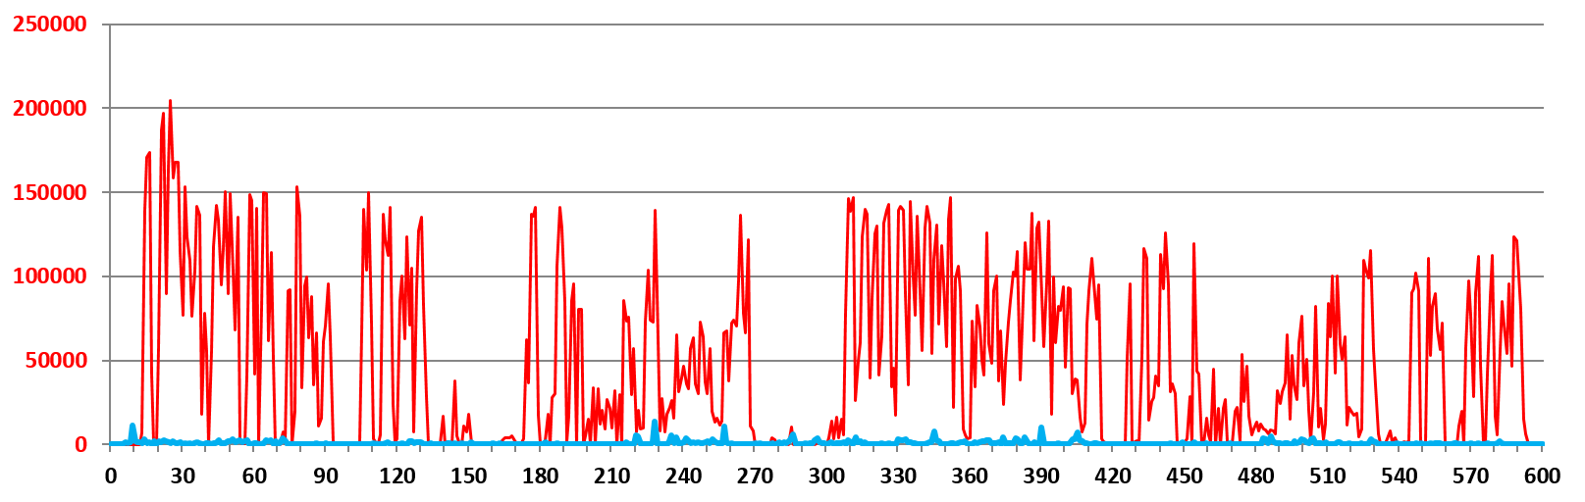
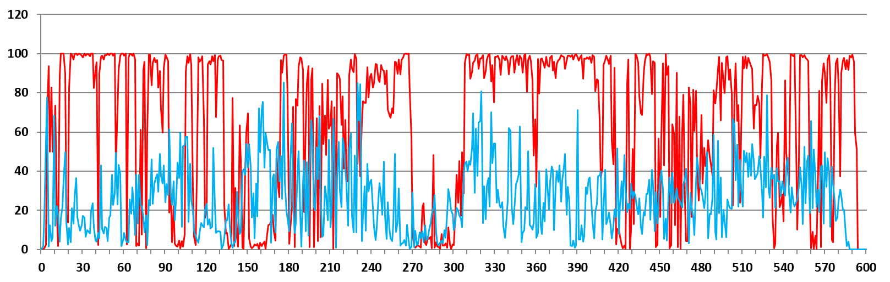
Frequency of A/D Write Events (by CPU Page-Walk)
VMexits due to EPT violation induced by CPU page-walker updates of guest A/D bits
Typical office applications workload
(e.g. web browsing, document editing, …)
Heavy memory workload
(e.g. intensive allocations, frequent process starts, …)
Percentage of A/D bit update generated EPT violations out of all violations
Source: Bitdefender* analysis

Slide 37
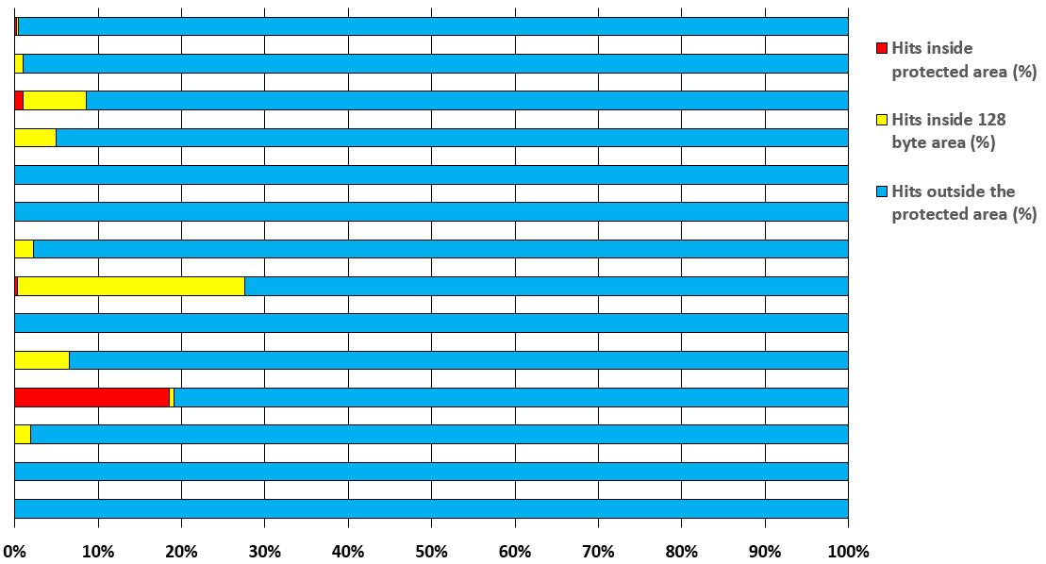
Potential Improvements of Fine-grain Memory Monitoring
User mode events
Kernel mode events
Source: Bitdefender* analysis

Slide 38
Security Trends
Memory introspection Promises, Capabilities, and Challenges
Hardware Extensions
Hypervisor Extensions
Memory Introspection Scenarios
Conclusions

Slide 39
Concluding Thoughts
Hypervisor-based Memory Introspection (HVMI) extends hardware isolation against advanced user and kernel threats
HVMI can be deployed in several usage scenarios from multi-VM servers to client endpoints
New Intel® CPU offers scalable inter and intra-VM memory introspection capabilities (with no overhead for VT nesting)
New features in the Xen* hypervisor expose required infrastructure for HVMI (altp2m, VMCS shadowing, …)

Slide 40
Additional Sources of Information
A PDF of this presentation is available from our Technical Session Catalog: www.intel.com/idfsessionsSF. This URL is also printed on the top of Session Agenda Pages in the Pocket Guide.
More info on VMFUNC and #VE extensions in Intel Software Developer Manuals
http://www.intel.com/content/www/us/en/processors/architectures-software-developer-manuals.html
Bitdefender* MI solution at booth number 752 in the showcase
Thank you!

Slide 41
Other Technical Sessions
Session ID | Title | Day | Time | Room
ISGS001 | Intel Security Solutions Architecture for the Internet of Things Era: Intel® IoT Platform and Gateway | Aug 18 | 11:00 am | 2004
ISGS002 | Hypervisor Extensions for Virtual Machine Memory Introspection | Aug 19 | 9:30 am | 2007
ISGS003 | Building a Cloud Scalable Data Exchange Layer (DXL) Service | Aug 20 | 9:30 am | 2005
ISGS004 | Biometric Authentication in Trusted Execution Environments | Aug 20 | 10:45 am | 2005
ISGS005 | Intel® Identity Protection Technology with Multi-Factor Authentication | Aug 20 | 1:00 pm | 2005
✓
✓
✓ = DONE

Slide 42
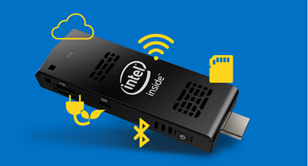
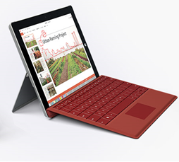

Completing an Online Session Evaluation by 10am Tomorrow Automatically Enters You in a Drawing to Win!
You will receive an email with a link to the online evaluation prior to the end of this session.
Day 1 Prize
Day 2 Prize
Day 3 Prize
Intel® Compute Stick (20)
Microsoft* Surface* 3 (6)
Dell Venue 10 7000 Series (4)
Winners will be notified by email
Copies of the complete sweepstakes rules are available at the Info Desk

Slide 43
Q&A

Slide 44
What will you develop?

Slide 45
Legal Notices and Disclaimers
Intel technologies’ features and benefits depend on system configuration and may require enabled hardware, software or service activation. Learn more at intel.com, or from the OEM or retailer.
No computer system can be absolutely secure.
Tests document performance of components on a particular test, in specific systems. Differences in hardware, software, or configuration will affect actual performance. Consult other sources of information to evaluate performance as you consider your purchase. For more complete information about performance and benchmark results, visit http://www.intel.com/performance.
Cost reduction scenarios described are intended as examples of how a given Intel-based product, in the specified circumstances and configurations, may affect future costs and provide cost savings. Circumstances will vary. Intel does not guarantee any costs or cost reduction.
This document contains information on products, services and/or processes in development. All information provided here is subject to change without notice. Contact your Intel representative to obtain the latest forecast, schedule, specifications and roadmaps.
Statements in this document that refer to Intel’s plans and expectations for the quarter, the year, and the future, are forward-looking statements that involve a number of risks and uncertainties. A detailed discussion of the factors that could affect Intel’s results and plans is included in Intel’s SEC filings, including the annual report on Form 10-K.
The products described may contain design defects or errors known as errata which may cause the product to deviate from published specifications. Current characterized errata are available on request.
No license (express or implied, by estoppel or otherwise) to any intellectual property rights is granted by this document.
Intel does not control or audit third-party benchmark data or the web sites referenced in this document. You should visit the referenced web site and confirm whether referenced data are accurate.
Intel Core, Intel Atom, Intel® Virtualization Technology for IA-32, Intel® 64 and Intel® Architecture (Intel® VT-x), Intel® Virtualization Technology for IA-32, Intel® 64 and Intel® Architecture (Intel® VT-x) with Extended Page Tables (Intel® VT-x with EPT), and the Intel logo are trademarks of Intel Corporation in the United States and other countries.
*Other names and brands may be claimed as the property of others.
© 2015 Intel Corporation.

Slide 46
Risk Factors
The above statements and any others in this document that refer to plans and expectations for the second quarter, the year and the future are forward-looking statements that involve a number of risks and uncertainties. Words such as "anticipates," "expects," "intends," "plans," "believes," "seeks," "estimates," "may," "will," "should" and their variations identify forward-looking statements. Statements that refer to or are based on projections, uncertain events or assumptions also identify forward-looking statements. Many factors could affect Intel's actual results, and variances from Intel's current expectations regarding such factors could cause actual results to differ materially from those expressed in these forward-looking statements. Intel presently considers the following to be important factors that could cause actual results to differ materially from the company's expectations. Demand for Intel's products is highly variable and could differ from expectations due to factors including changes in business and economic conditions; consumer confidence or income levels; the introduction, availability and market acceptance of Intel's products, products used together with Intel products and competitors' products; competitive and pricing pressures, including actions taken by competitors; supply constraints and other disruptions affecting customers; changes in customer order patterns including order cancellations; and changes in the level of inventory at customers. Intel's gross margin percentage could vary significantly from expectations based on capacity utilization; variations in inventory valuation, including variations related to the timing of qualifying products for sale; changes in revenue levels; segment product mix; the timing and execution of the manufacturing ramp and associated costs; excess or obsolete inventory; changes in unit costs; defects or disruptions in the supply of materials or resources; and product manufacturing quality/yields. Variations in gross margin may also be caused by the timing of Intel product introductions and related expenses, including marketing expenses, and Intel's ability to respond quickly to technological developments and to introduce new products or incorporate new features into existing products, which may result in restructuring and asset impairment charges. Intel's results could be affected by adverse economic, social, political and physical/infrastructure conditions in countries where Intel, its customers or its suppliers operate, including military conflict and other security risks, natural disasters, infrastructure disruptions, health concerns and fluctuations in currency exchange rates. Results may also be affected by the formal or informal imposition by countries of new or revised export and/or import and doing-business regulations, which could be changed without prior notice. Intel operates in highly competitive industries and its operations have high costs that are either fixed or difficult to reduce in the short term. The amount, timing and execution of Intel's stock repurchase program could be affected by changes in Intel's priorities for the use of cash, such as operational spending, capital spending, acquisitions, and as a result of changes to Intel's cash flows or changes in tax laws. Product defects or errata (deviations from published specifications) may adversely impact our expenses, revenues and reputation. Intel's results could be affected by litigation or regulatory matters involving intellectual property, stockholder, consumer, antitrust, disclosure and other issues. An unfavorable ruling could include monetary damages or an injunction prohibiting Intel from manufacturing or selling one or more products, precluding particular business practices, impacting Intel's ability to design its products, or requiring other remedies such as compulsory licensing of intellectual property. Intel's results may be affected by the timing of closing of acquisitions, divestitures and other significant transactions. A detailed discussion of these and other factors that could affect Intel's results is included in Intel's SEC filings, including the company's most recent reports on Form 10-Q, Form 10-K and earnings release.
Rev. 4/14/15

Slide 47
Backup

Slide 48
Additional Info on Xen* Patches
Intel submitted Xen* patches
http://lists.xen.org/archives/html/xen-devel/2015-06/msg01319.html
http://lists.xen.org/archives/html/xen-devel/2015-07/msg01943.html
Bitdefender* submitted Xen patches
http://xenbits.xenproject.org/gitweb/?p=xen.git&a=search&h=refs%2Fheads%2Fstaging&st=author&s=rcojocaru
http://xenbits.xenproject.org/gitweb/?p=xen.git&a=search&h=refs%2Fheads%2Fstaging&st=author&s=mdontu
http://lists.xen.org/archives/html/xen-devel/2015-06/msg02113.html
http://lists.xen.org/archives/html/xen-devel/2015-06/msg02112.html
http://lists.xen.org/archives/html/xen-devel/2015-06/msg02111.html

